Slide 1
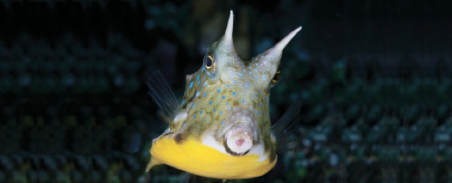
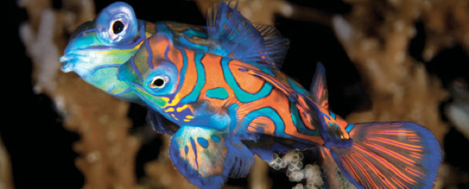
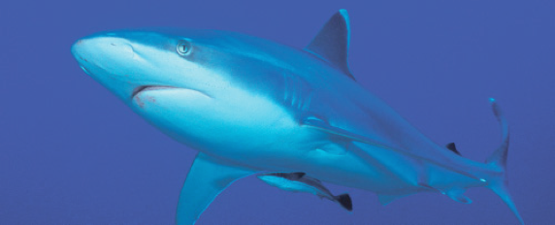
Lesson 9 Taxonomy III
Ichthyology
Shanghai Ocean University
Fall, 2020

Slide 2
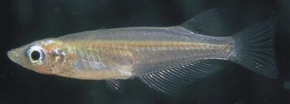
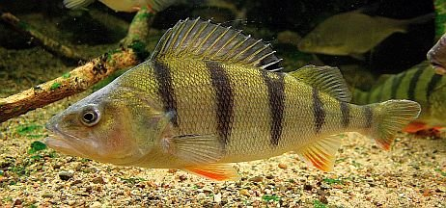
Teleosts III – Silversides to
Perches

Slide 3
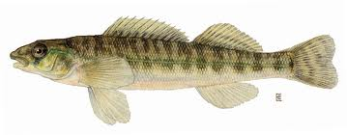
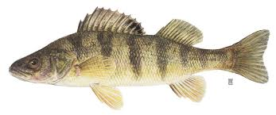
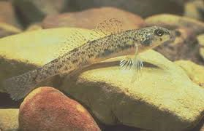
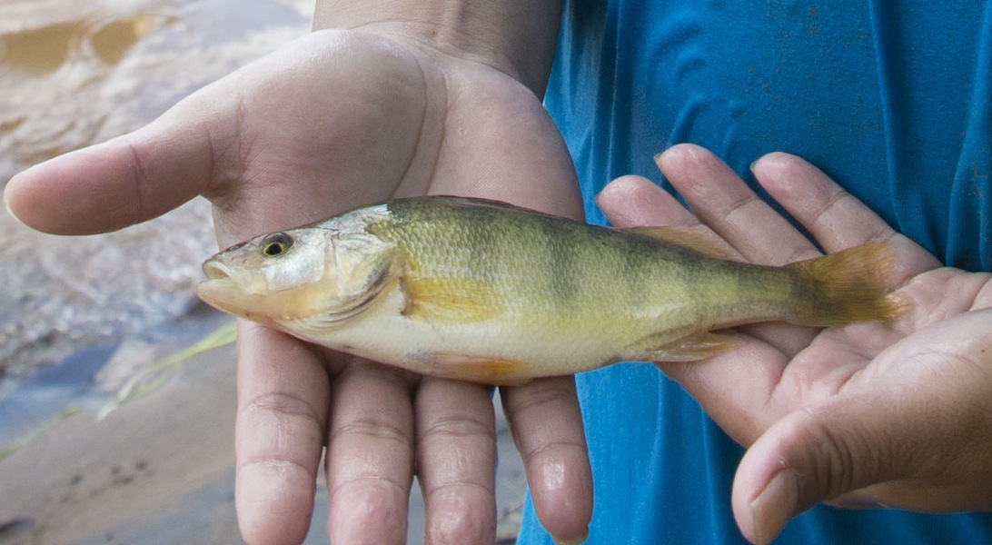
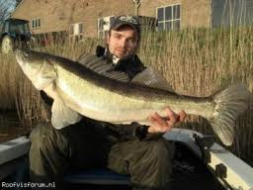
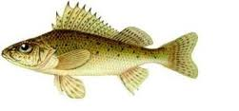
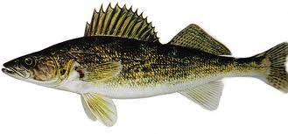
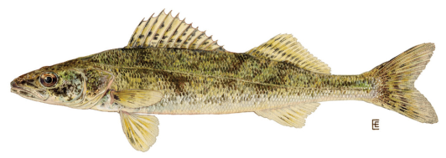
Family Percidae
(perches and darters)
-One of the most speciose fish families in North America
-Elongate body
-Spiny, divided dorsal fin
-190 species in North America, but 155 are darters
-19 in Wisconsin; 15 are darters
-darters are benthic; lack swimbladder
-Other prominent members of Percidae
-walleye
-sauger
-zander
-ruffe
yellow perch

Slide 4
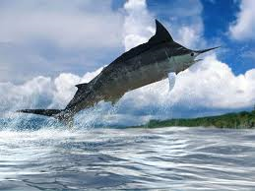
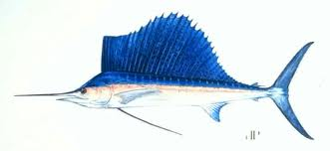
Family Xiphiidae
(billfishes)
Hydrodynamic body form
Streamlined open ocean predators
Some of the fastest fish in the
ocean
Common feature: long, pointed
rostrum
-Prized gamefish; featured by
Hemingway
-Blue marlin can exceed 1000 lbs
More info on the blue marlin (link)

Slide 5
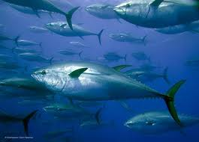
Family Scombridae
(tunas and mackerels)
The ‘perfect’ hydrodynamic body form.
(thunniform swimmers)
-narrow caudal peduncle
-broad, but shallow tail
-swept back fins
-tremendous muscle mass
-can even generate some body
heat
-Global stocks plummeting!!!
Bluefin tuna sells for $396,000 (link)
Bluefin Tuna not ruled endangered (link) - 2011

Slide 6
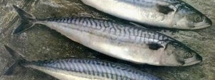
Scomberomorus niphonius 蓝点马鲛鱼
Pneumatophorus japonicus 鲐鱼

Slide 7
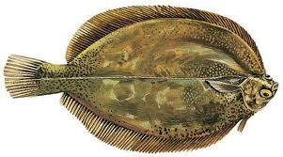
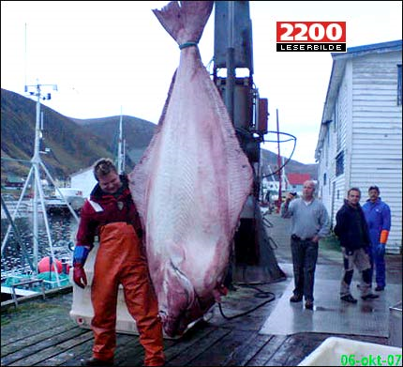
Family Pleuronectidae
(right-eye flounders)
Several families of flatfishes – this is just one
All exhibit unusual development resulting in both
eyes on one side of body; lie flat on bottom on
opposite side
-Important food fish
-Other flatfishes include
sole, halibut, and other
flounders
sole
693 lb halibut

Slide 8
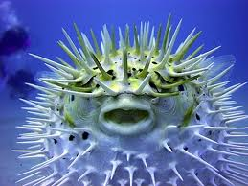
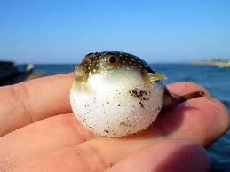
Family Tetraodontidae
(puffers)
“Tetra” = 4; “dont” = teeth
Tetraodontids have four teeth
flattened into crushing plates
-Other prominent/unusual characteristics include
spiny covering
ability to ‘puff up’ by gulping in water or air
independent eye movement

Slide 9
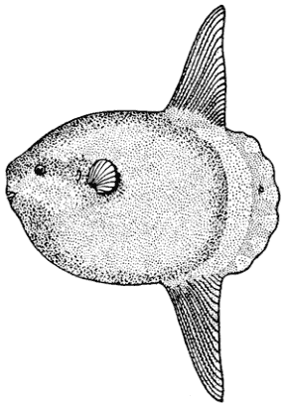
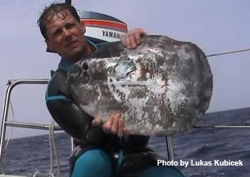
Family Molidae
(ocean sunfishes)
Largest bony fish; adults up to 5000 lbs
Very unusual body form; depth up to twice that of
length
-No caudal fin (i.e., no tail)
-Swims by ‘flapping’ LONG
dorsal and anal fins
-Pelagic wanderer; feeds on jellyfish
-Recent conservation concerns:
bycatch and ‘finning’
Fish Guys!

Slide 10
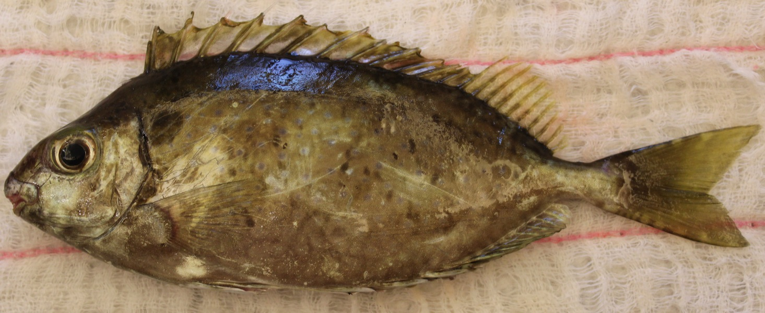
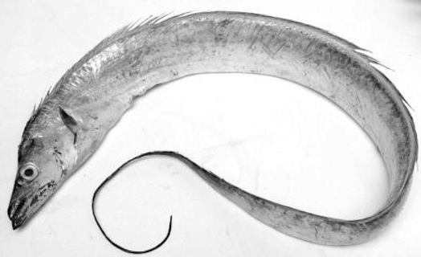
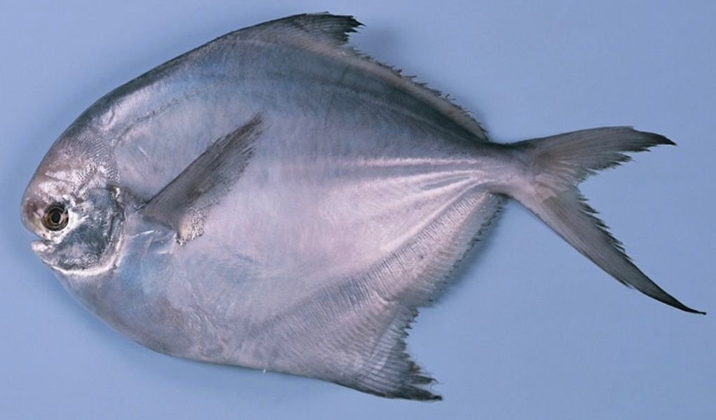
Acanthuroidei Siganus fuscessens 褐篮子鱼
Trichiuroidei Trichiurus haumela 带鱼
(cutlassfishes)
Stromateoidei Pampus argenteus 银鲳

Slide 11
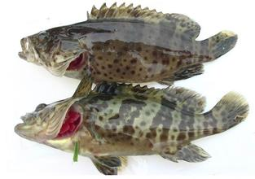
Sinipercidae Siniperca undulata 波纹鳜 (Chinese perch)
Serranidae Epinephelus awoara 青石斑鱼 (grouper)

Slide 12
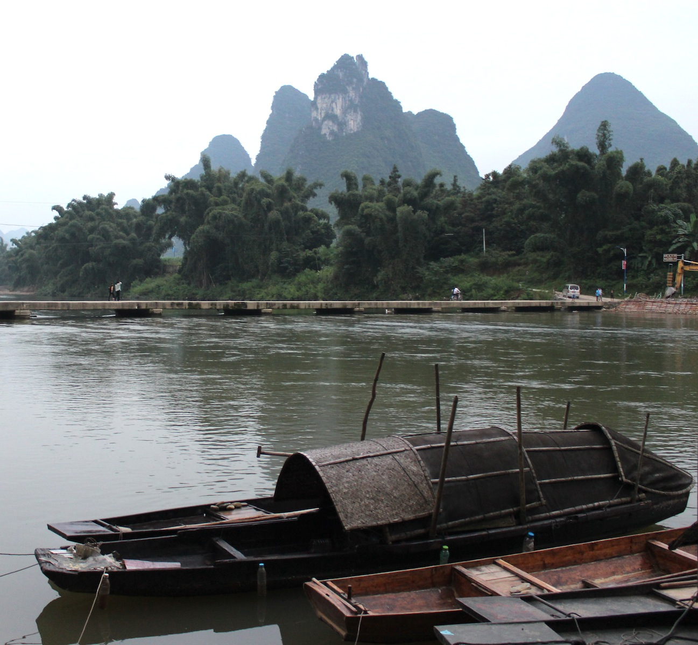
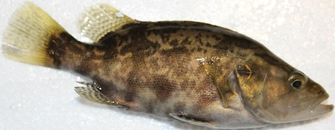
广西，小长安
Coreoperca whiteheadi

Slide 13
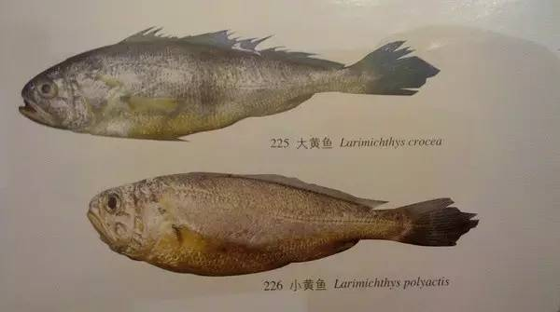
Sciaenidae Pseudosciaena croea 大黄鱼；Psedosciaena polyactis 小黄鱼；
(Yellow croaker)

Slide 14
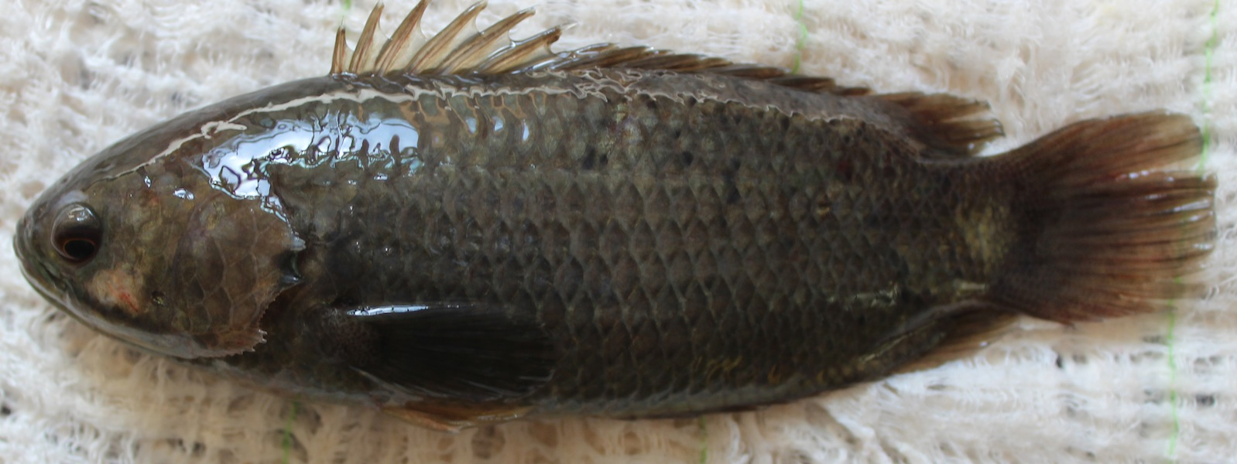
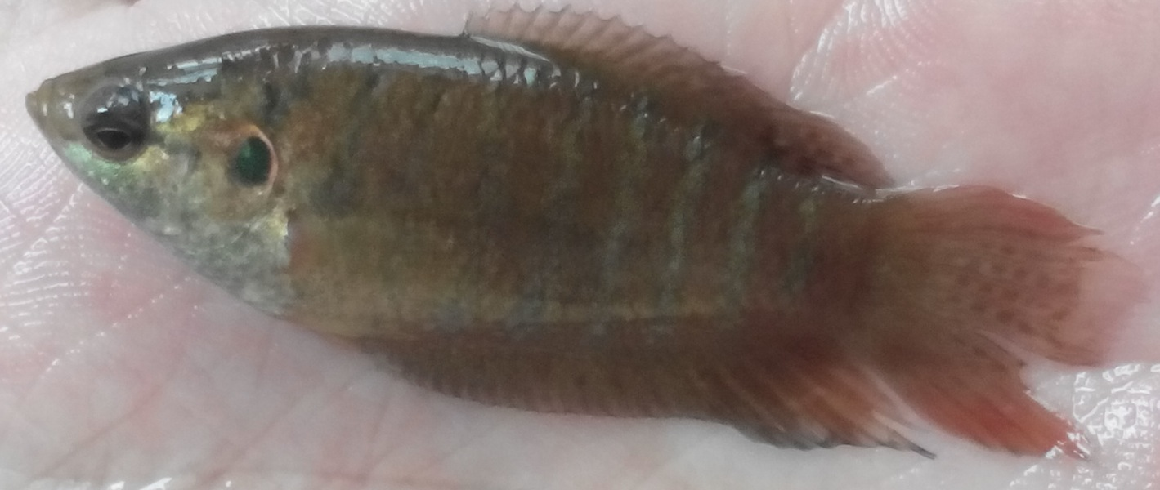
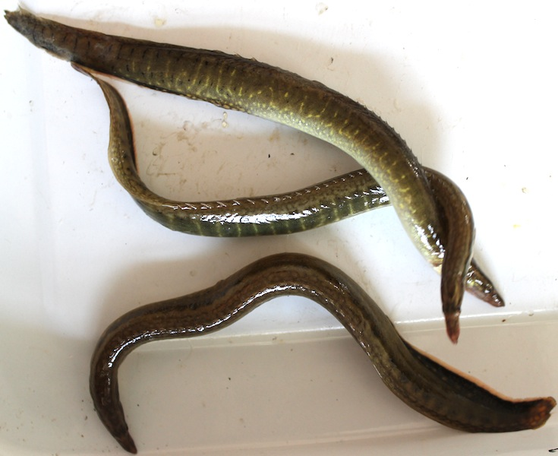
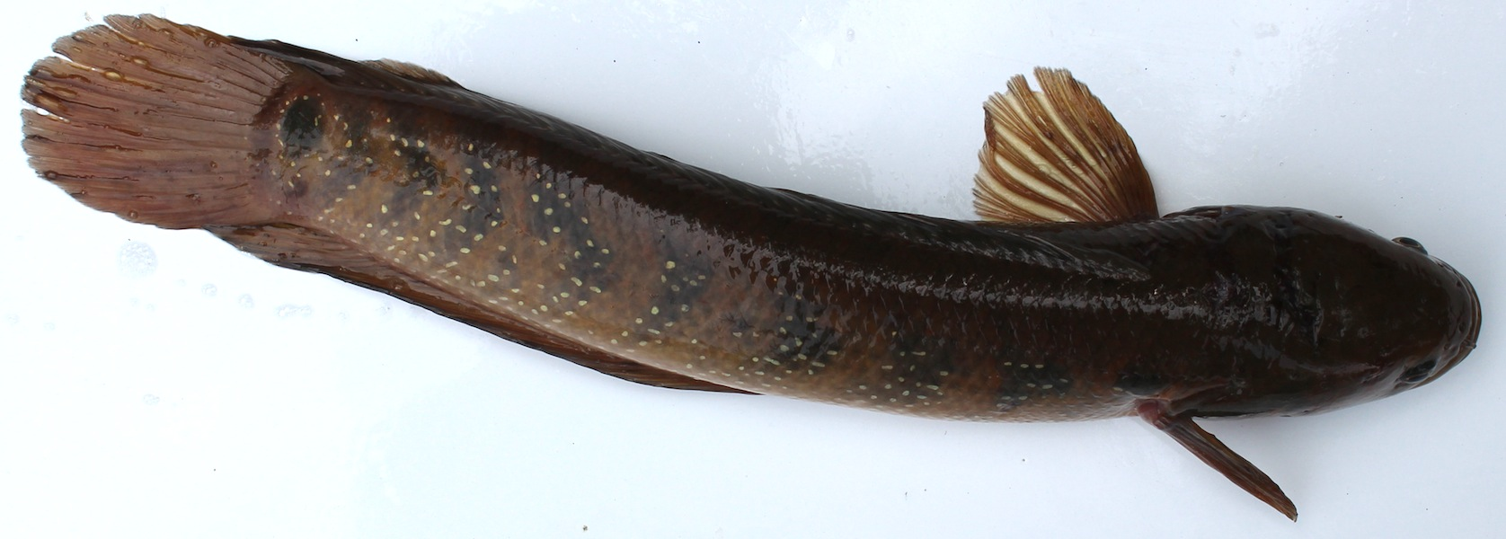
Anabantoidei Anabas scandens 攀鲈；Macropodus chinensis 圆尾斗鱼
Channidae Channa asiatica乌鳢
Mastacembeloidei Mastacembelus aculeatus 刺鳅

Slide 15
Trends during teleostean phylogeny
徐昊
Trends during teleostean phylogeny

Slide 16
Trends during teleostean phylogeny
Trends in five areas can be readily linked to functional improvements that contributed to teleostean success
reduction in bony elements,
repositioning and elaboration of the dorsal fin,
change in placement and function of paired fins,
structural modifications to and interaction between the caudal fin and gas bladder,
and jaw improvements.

Slide 17
Presentation for next week (Dec 6)
陈滢萱
Compare R-selected vs. K-selected reproduction strategy, give some examples.
顾佳
Introduce the phenomenon of sex change in fishes, give examples and explain how it evolved.
祝悦
Describe three major differences between the sexes in fish, and give examples.
王昉欣
Describe different types of parental care in fishes.

Slide 18
HWK
Homework 8.docx
due on Dec 6
No late hand-in will be graded
Read Chapter 14&15

Slide 19
Have a nice week!
My fishing trips

